Slide 1
AI and the Future of Skills – Current Project Plans
January 2024

Slide 2
AI and the Future of Skills
Project goal: Develop measures of AI capabilities for policy makers
Focus: capabilities with implications for education, work and everyday life
Specifically: how will AI change what students need to learn?
Going beyond learning about AI itself
Not focused directly on how AI may change the teaching process
What human capabilities will be more important or less important?
Development project until 2025-26
Provide an initial set of measures with illustrations of their use
Transition to become an ongoing programme in 2026-27

Slide 3
Three Types of Outputs
Scales to measure AI capabilities
Task descriptions to illustrate human-AI collaboration
Collaboration based on AI capabilities measured by the scales
Tasks found at work, in education and everyday life
Implications of the evolution of tasks with human-AI collaboration
For education
For other sectors

Slide 4
Developing a scale

Slide 5
AI measures of four broad capabilities
Language
Sensory-motor
Reasoning
Social
Language understanding
Manipulation
Meta-cognition Critical thinking
Social perception
Vision
Social reasoning and decision-making
Language generation
Problem solving
Planning
Knowledge, memory and learning
Social action
Integration
…
…
…

Slide 6
Ideal Scale
AI Language Capability Scale
Using
Expert Judgment
5
Too hard
Near-human NLP:
evaluate truth in nonfiction
detect rhetorical structures
segment factual claims
tackle advanced comprehension tasks
4
Using
Direct assessments
3
AI benchmarks
PISA and PIAAC tests
2
Basic features of NLP:
retrieve simple information
answer simple questions or requests
often using keywords
Using
Expert Judgment
Too easy
1

Slide 7
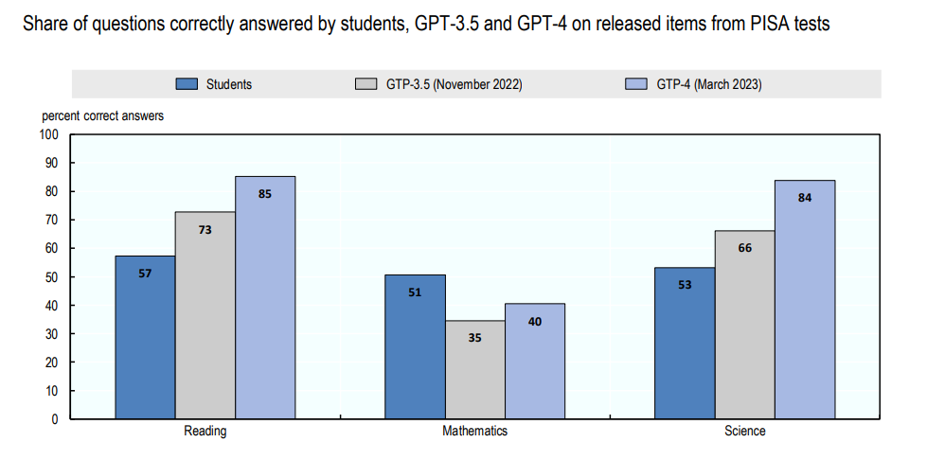
An example of a direct AI assessment
Notes:
Our March report (Is Education Losing the Race with Technology?) showed AI made big changes with respect to adult literacy, moving from the 50th to the 90th percentile of adults from 2016 to 2021.
Last month we looked at AI improvements measured by PISA over the past year, with substantial improvement in all 3 core domains. This unpublished result on PISA over a single year seems as big as the change we previously saw in adult literacy over 5 years.
Note that the low performance on math is similar to the problems with math often reported for ChatGPT.
(Caveats: only released items; not weighted for distribution of difficulty)

Slide 8
Cross-walk to tasks
Human Reading Ability Scale (O*NET)
AI Language Capability Scale
Recognizing and evaluating factual claims in nonfiction text
7
Understand an instruction book on repairing missile guidance systems
5
6
4
5
Understand an
apartment lease
3
4
3
2
Finding the content most relevant to a specific user information need
2
1
Understand signs
on the highway
1
Notes:
We are going to work out a way to cross-walk from our scales to human skills in O*Net

Slide 9
Task descriptions

Slide 10
Evolution of an Example Task: Changing Human Role
Original task
Structuring task, collecting information
Drafting text and revising
With ChatGPT
Drafting request for ChatGPT
Reviewing ChatGPT draft and identifying errors to fix
Collecting information and revising ChatGPT draft
With improved ChatGPT
Using ChatGPT to review itself and identify alternative arguments
Instructing ChatGPT on revision

Slide 11
Task Descriptions: Sampling Tasks (examples)
Reasoning
Natural scientist conducting an experiment
Manager reviewing an application
Administrative assistant preparing a mailing
Sensory-motor
Notes:
We want a wide range of tasks that reflect a variety of skills across the domains in which we have made our scales.

Slide 12
Implications

Slide 13
Implications: Acceptance
AI will soon perform many cognitive tasks at near-human levels
In many contexts, we will perform cognitive tasks with AI assistance
AI assistance will reduce cognitive inequality: People with relatively weaker cognitive skills will be helped more
Schools need to embrace the use of AI assistance
AI capabilities will force us to question the value of many areas of study
Development of physical and social skills may be more important for work
Start considering the types of things that teachers do and the impact of AI capabilities
Notes:
If AI makes some skills obsolete for adults, when should those skills continue to be taught in education?

Slide 14
Implications: Longer-Term Challenge
Most students in school today will spend most of their adult lives not needing to work
Education needs to focus on helping students find meaningful activities and motivate themselves to pursue them
A curriculum focused on competences that students “need to learn” will become increasingly counter-productive: motivation is what matters
Education has a critical role in the transition to a post-work society
Notes:
Considering high impact, even if (potentially) low plausibility

Slide 15
Thank you!
For more information:
futureofskills@oecd.org
www.oecd.org/education/ceri/future-of-skills.htm

